Slide 1
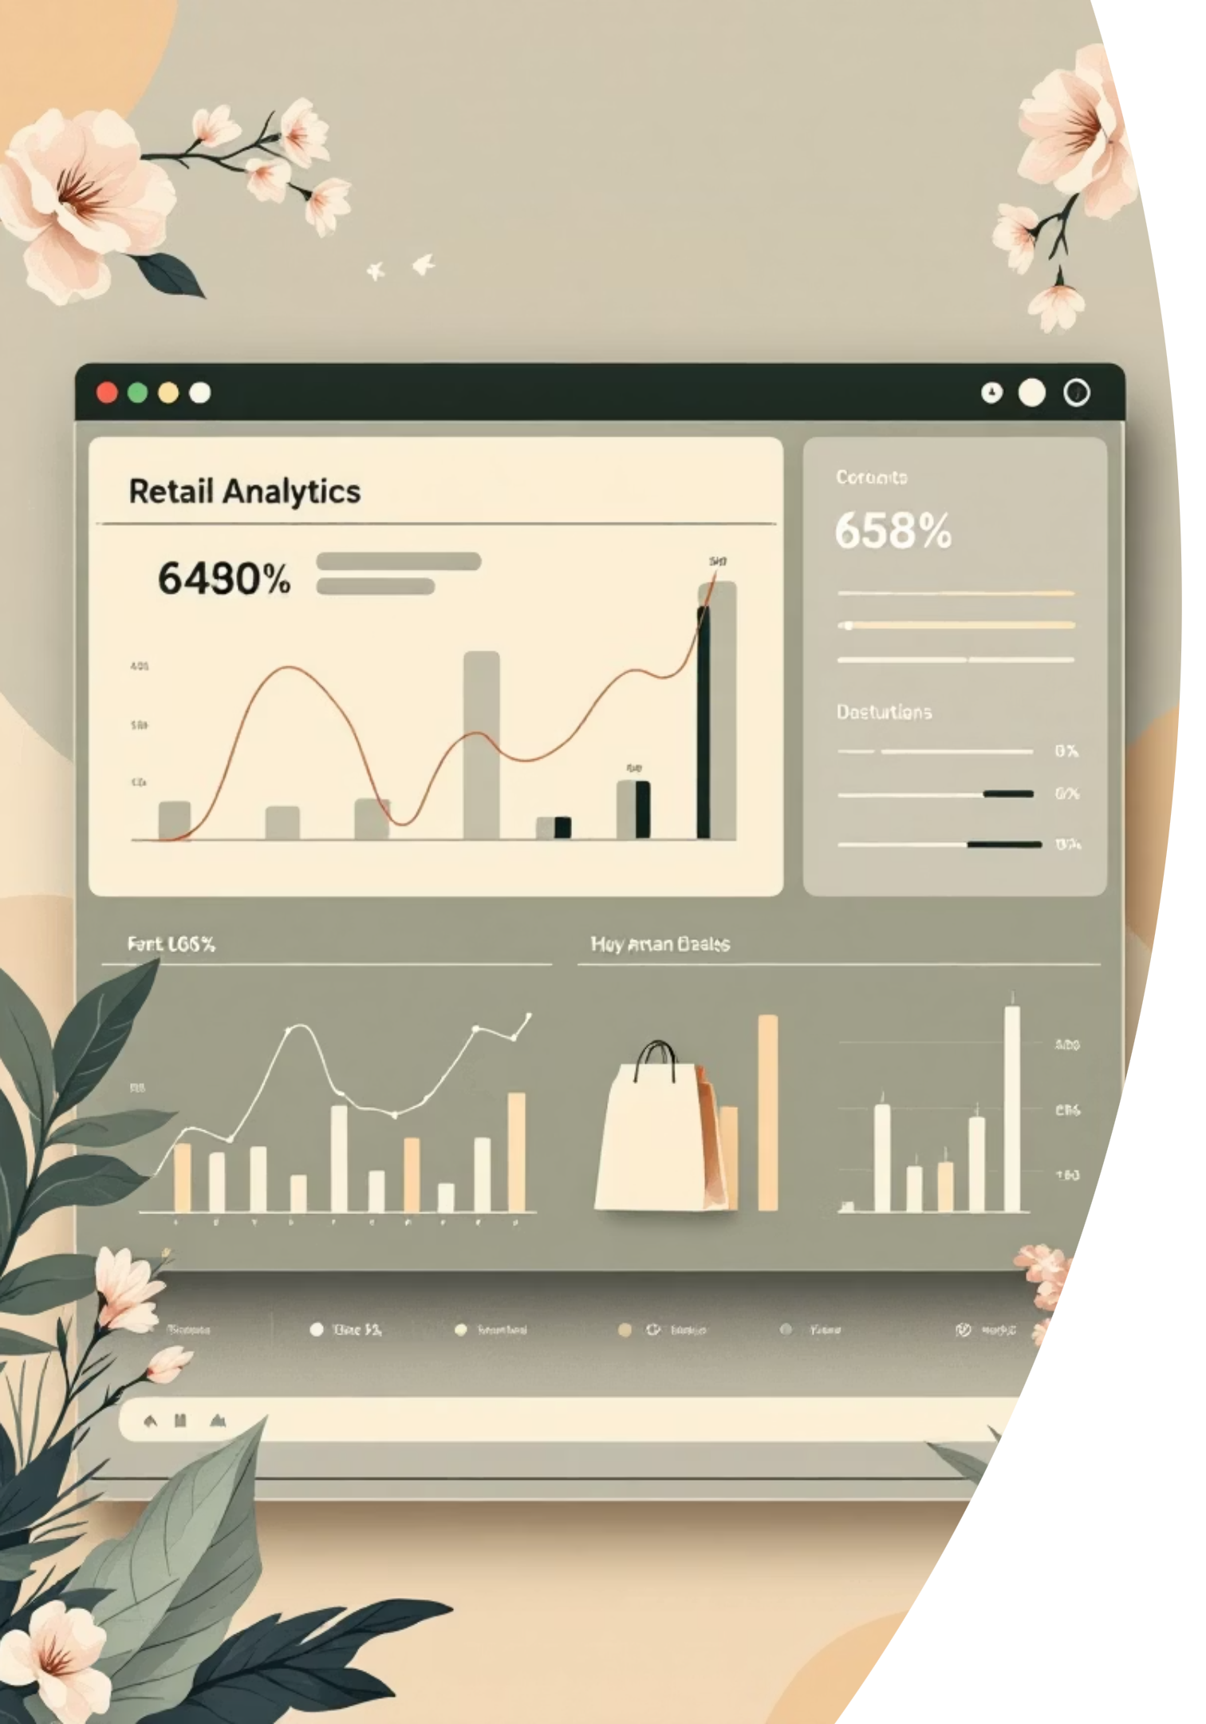
Customer Shopping Behaviour Analysis
Analyzing transactional data to identify purchasing patterns, sales trends, and high-value customers through SQL, Python, and Power BI.

Slide 2
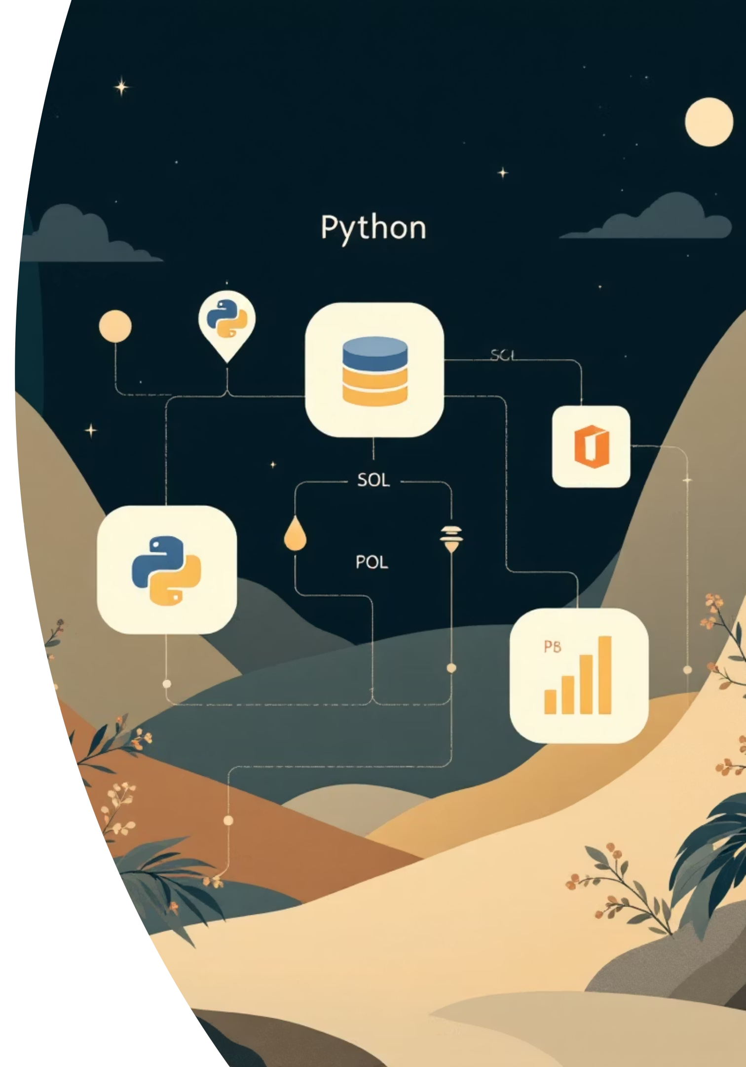
Project Scope
Data-Driven Retail Insights
Dataset Overview
Technical Approach
3,900 transactions analyzed
Python for data cleaning
18 data columns covering customer profiles, transactions, and behavioral indicators
SQL for business analysis
Power BI for visualization

Slide 3
Data Preparation in Python
01
02
Data Loading & Exploration
Missing Data Handling
Imported dataset using Pandas, checked structure with df.info() and summary statistics
Imputed 37 missing Review Rating values using median rating per product category
03
04
Feature Engineering
Database Integration
Created age_group and purchase_frequency_days columns for deeper analysis
Connected to MySQL and loaded cleaned data for SQL analysis

Slide 4

Customer Demographics
44
68%
50
Average Age
Male Customers
Locations
Customer age ranges from 18 to 70 years
Customers across diverse geographic regions
Gender distribution shows male shopping dominance

Slide 5
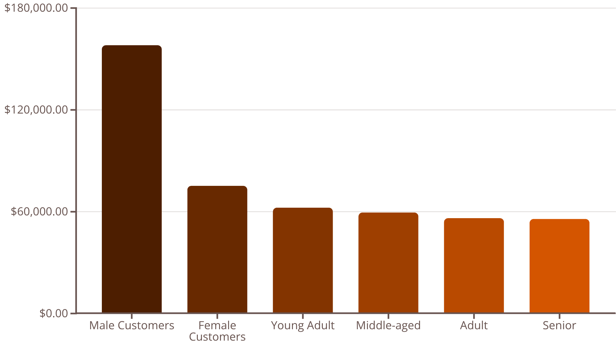
Revenue Analysis Insights
Key Findings
Male customers generate 2x more revenue than female customers
Young Adults lead revenue contribution across age groups

Slide 6
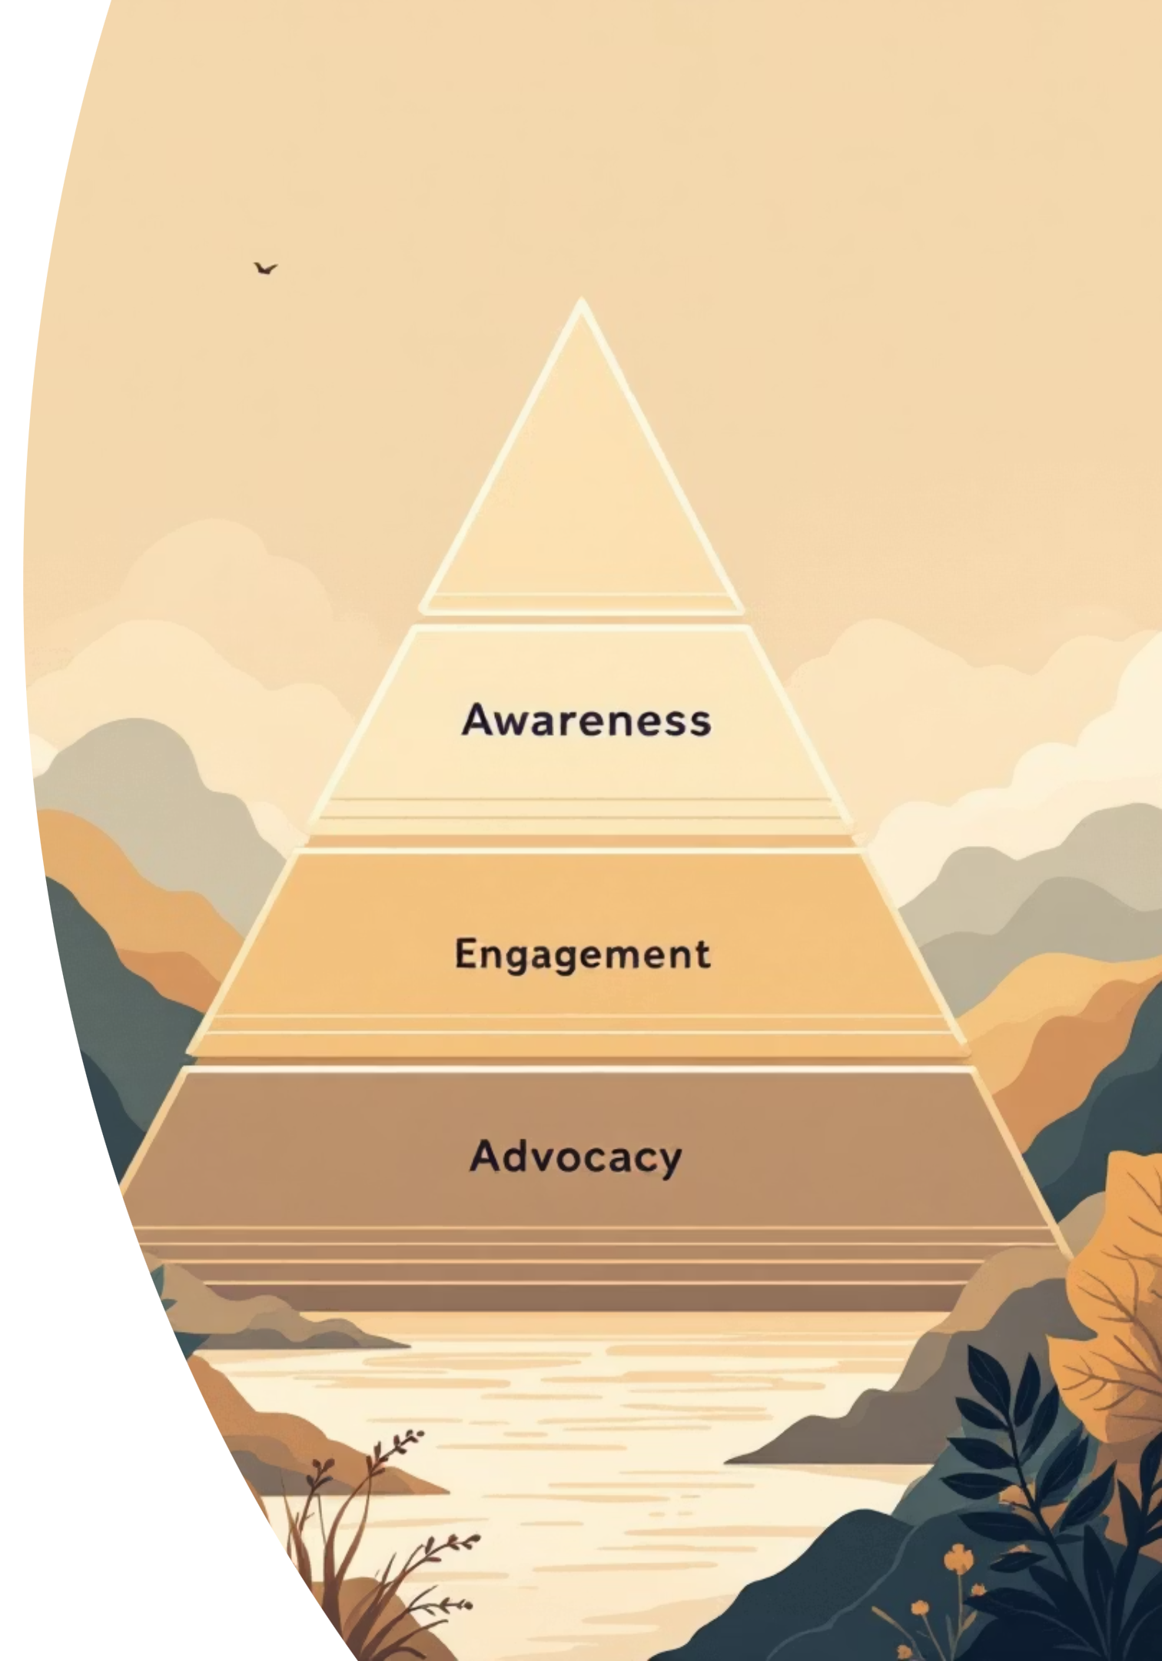
Customer Segmentation Results
Loyal Customers
Returning Customers
3,116 customers
701 customers
Highest purchase frequency and engagement
Moderate repeat purchase behavior
New Customers
83 customers
First-time buyers with growth potential
Customer segmentation based on purchase history reveals strong loyalty base with opportunity to convert new buyers.

Slide 7

Product Performance Analysis
Top Products by Rating
Discount-Dependent Products
Sandals - 3.82 rating
Boots - 3.79 rating
Hat - 50% discount rate
Gloves - 3.78 rating
Sneakers - 49.66%
Hat - 3.78 rating
Coat - 49.07%
Handbag - 3.78 rating
Sweater - 48.17%
Pants - 47.37%

Slide 8
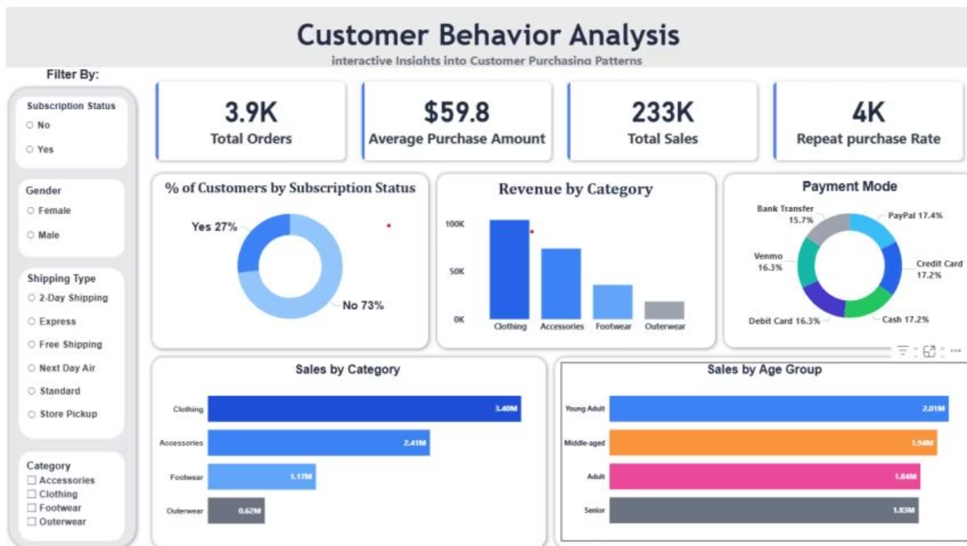
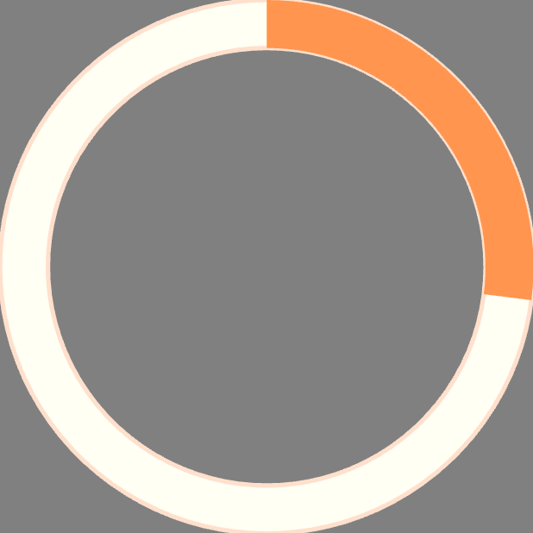


Power BI Dashboard Overview
27%
$59.8
3.9K
Subscription Rate
Avg Purchase
Total Orders
Opportunity to grow subscriber base
Consistent spending across customers
Strong transaction volume

Slide 9
Strategic Recommendations
1
2
3
Focus on High-Revenue Categories
Target Young Adult Customers
Improve Subscription Conversion
Allocate more resources to Clothing and Accessories for improved revenue growth
Design personalized campaigns and loyalty programs for highest-contributing age group
Encourage non-subscribers with exclusive discounts and free shipping benefits
4
5
Optimize Underperforming Categories
Maintain Payment Flexibility
Re-evaluate pricing and promotions for Footwear and Outerwear
Continue supporting multiple payment modes to reduce cart abandonment

Slide 10
Business Impact
Revenue Growth
Customer Engagement
Improved Retention
Data-driven insights support strategic marketing and inventory decisions
Targeted campaigns increase conversion rates and lifetime value
Subscription strategies boost recurring revenue and loyalty

